Slide 1
Introduction to AI: From Buzzwords to Building - Navigating the AI Landscape in Nigeria
Learning Objectives
By the end of this session, you will:
Decipher the Hierarchy: Understand the relationship between AI, ML, and DL, and other concepts.

Slide 2
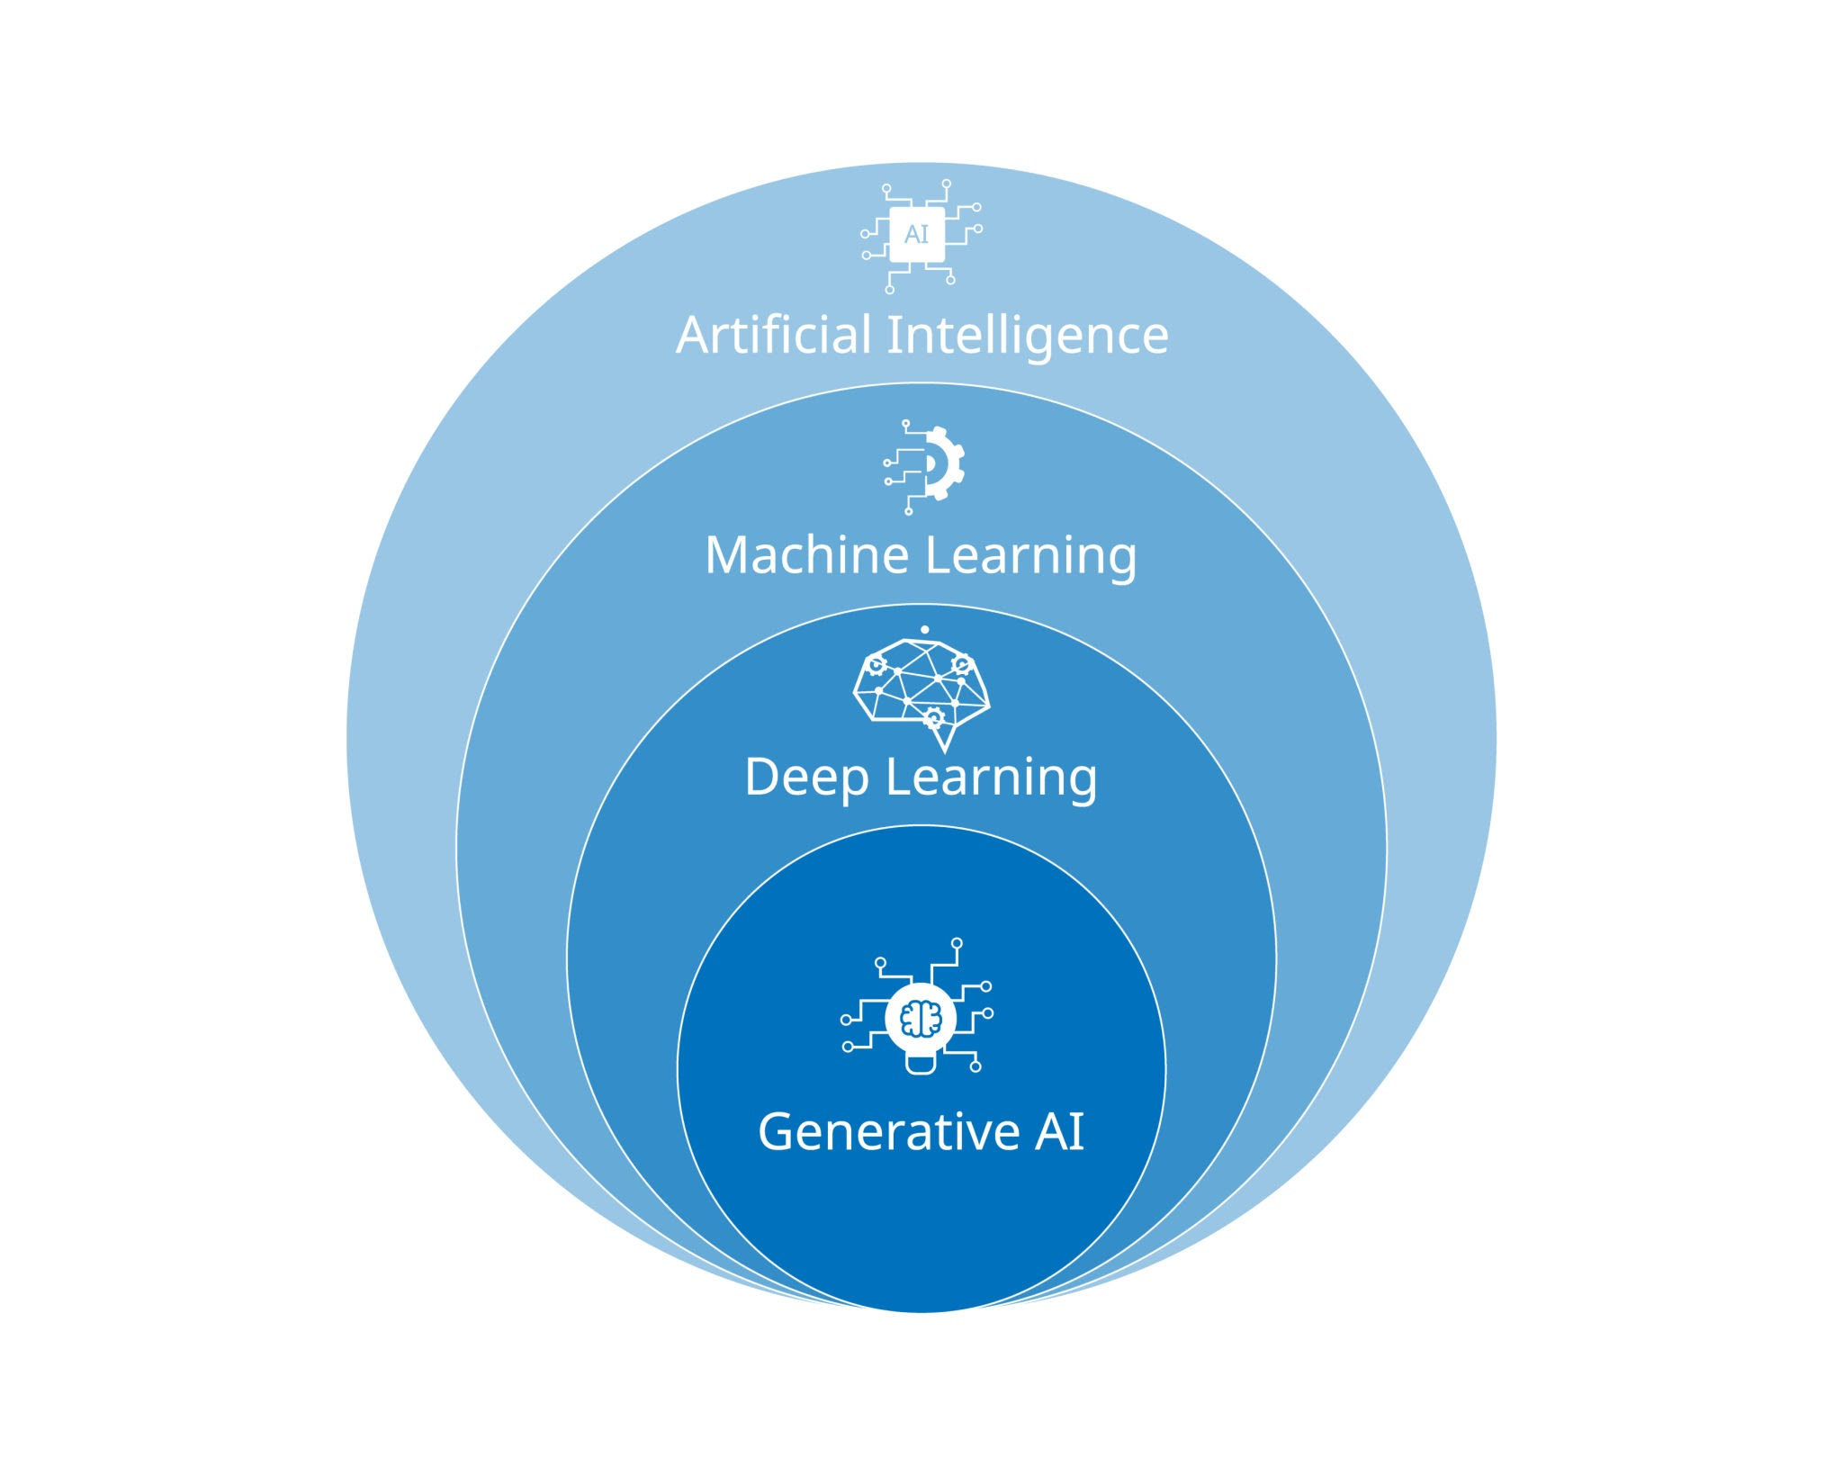
"Nesting Dolls" of AI
Key Concept: AI is the vision; ML is the method; DL is the specialized tool.
Artificial Intelligence (AI): The broad field of creating systems that simulate human intelligence (e.g., playing chess, recognizing faces).
Machine Learning (ML): A subset of AI that uses statistical techniques to enable machines to "learn" from data without being explicitly programmed for every scenario.
Deep Learning (DL): A specialised subset of ML using multi-layered neural networks (inspired by the human brain) to solve complex tasks like image and speech recognition.
Notes:
Two models with the same accuracy behave very differently in deployment. Why? Distribution shift and variance: Because accuracy is an average, while deployment exposes models to changing data distributions and different levels of variance.

Slide 3
The Broad Spectrum (Intelligence Levels)
Artificial Narrow AI (ANI): AI systems designed and trained to perform a specific task or solve a defined problem without possessing general cognitive abilities.
Artificial General Intelligence (AGI): An autonomous system that possesses the ability to understand, learn, and apply knowledge across any intellectual task at a level equal to a human being.
Artificial Super Intelligence (ASI): A hypothetical form of AI that surpasses human intelligence across all fields, including creativity, general wisdom, and social skills.
Notes:
Two models with the same accuracy behave very differently in deployment. Why? Distribution shift and variance: Because accuracy is an average, while deployment exposes models to changing data distributions and different levels of variance.

Slide 4
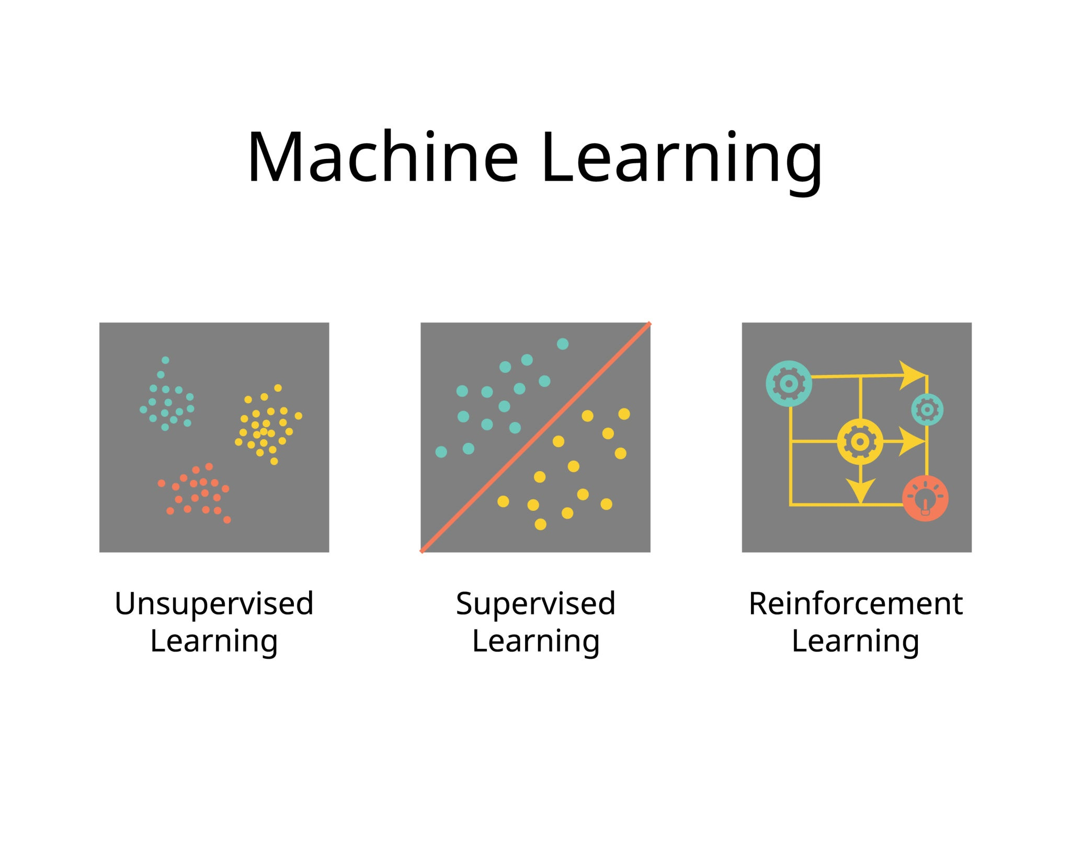
Core Learning Paradigms
Supervised Learning: A ML paradigm where the model is trained on a labeled dataset, mapping input features to known output targets.
Unsupervised Learning: A method used to identify underlying patterns, structures, or clusters within a dataset without the guidance of pre-existing labels.
Reinforcement Learning: An agent-based learning process where an entity learns to make sequences of decisions by maximizing a cumulative reward signal through trial-and-error interaction with an environment.
Semi-Supervised Learning: A technique that combines a small amount of labeled data with a large amount of unlabeled data during training to improve learning accuracy.
Self-Supervised Learning: A form of unsupervised learning where the system generates its own labels from the input data, typically by hiding part of the input and predicting it.
Notes:
Two models with the same accuracy behave very differently in deployment. Why? Distribution shift and variance: Because accuracy is an average, while deployment exposes models to changing data distributions and different levels of variance.

Slide 5
Specialized Model Techniques: Data-Efficient Techniques
Transfer Learning: A research problem in ML that focuses on storing knowledge gained while solving one problem and applying it to a different but related problem.
Zero-Shot Learning (ZSL): A ML paradigm where a model is designed to classify or recognize unseen categories by leveraging auxiliary semantic information, such as attribute descriptions or word embeddings, without having seen explicit training examples for those classes.
Few-Shot Learning (FSL): A subfield of ML focused on developing algorithms that can generalize to new tasks or categories from a very limited number of labeled training samples, typically by utilizing prior knowledge or meta-learning strategies.
Meta-Learning: Often described as "learning to learn," this technique involves training models on a variety of learning tasks so they can adapt to new, unseen tasks with minimal data and rapid optimization.
Explainable AI (XAI): A suite of methods and techniques that enable human users to understand and trust the internal decision-making logic of "black-box" machine learning models, ensuring transparency and accountability.
Notes:
Two models with the same accuracy behave very differently in deployment. Why? Distribution shift and variance: Because accuracy is an average, while deployment exposes models to changing data distributions and different levels of variance.

Slide 6
Specialized Model Techniques: Advanced Architectures
Federated Learning: A decentralized machine learning approach that trains an algorithm across multiple edge devices or servers holding local data samples, without exchanging the data itself.
Ensemble Learning: A meta-approach that combines the predictions of multiple base models (such as Bagging, Boosting, or Stacking) to improve overall generalizability and robustness compared to any single constituent model.
Multimodal Learning: The development of models capable of processing, relating, and fusing information from multiple distinct types of input data, such as simultaneous text, image, and audio streams.
Neuro-Symbolic AI: A hybrid approach that integrates the pattern recognition strengths of neural networks with the symbolic reasoning and logic-based capabilities of traditional AI to enhance complex problem-solving.
Notes:
Two models with the same accuracy behave very differently in deployment. Why? Distribution shift and variance: Because accuracy is an average, while deployment exposes models to changing data distributions and different levels of variance.

Slide 7
Specialized Model Techniques: Generative Systems
Time Series & Sequence Models: Architectures like LSTMs, GRUs, and Transformers designed specifically to handle temporal dependencies and data where the order of observations is critical, i.e., to process data points indexed in temporal order or sequential arrangements.
Graph-Based Models: Architectures like Graph Neural Networks (GNNs) designed to operate on non-Euclidean data structures, where the relationship (edge) between entities (nodes) is the primary feature. Models designed to capture and process data represented as graphs, emphasizing the relationships and dependencies between nodes.
Generative AI (GenAI): A category of deep learning models, such as LLMs, GANs, VAEs, or Diffusion Models, capable of generating novel synthetic data (text, images, or audio) that mimics the statistical distribution of the training data.
Notes:
Two models with the same accuracy behave very differently in deployment. Why? Distribution shift and variance: Because accuracy is an average, while deployment exposes models to changing data distributions and different levels of variance.

Slide 8
Key Fields of Application
Computer Vision (CV): A field of AI that enables computers to derive meaningful information from digital images, videos, and other visual inputs to perform tasks like object detection or segmentation.
Natural Language Processing (NLP): The intersection of linguistics and AI focused on the interaction between computers and human language, specifically regarding the processing and analysis of large datasets of textual or vocal data.
Anomaly Detection: The identification of rare items, events, or observations which raise suspicions by differing significantly from the majority of the data.
Notes:
Two models with the same accuracy behave very differently in deployment. Why? Distribution shift and variance: Because accuracy is an average, while deployment exposes models to changing data distributions and different levels of variance.

Slide 9
Essential AI Terminology
To talk the talk, you need the vocabulary:
Data: The "fuel" for AI. It can be structured (tables) or unstructured (images, text).
Algorithm: A set of rules or instructions given to an AI to help it learn.
Model: The "output" of training—an algorithm that has learned to recognize patterns.
Training vs. Inference:
Training: Teaching the model using data.
Inference: Putting the model to work on new, unseen data.
Notes:
Two models with the same accuracy behave very differently in deployment. Why? Distribution shift and variance: Because accuracy is an average, while deployment exposes models to changing data distributions and different levels of variance.

Slide 10
Nigerian AI Landscape
The goal of the programme is to make Nigeria not just a consumer of AI, but a massive laboratory for solving real-world problems.
Sector | Application
Fintech | Fraud detection, credit scoring for the unbanked (e.g., Carbon, OPay).
Agriculture | Crop disease detection via smartphone photos, yield prediction.
Healthcare | AI-driven diagnostic tools for rural clinics with limited doctors.
E-commerce | Personalised recommendations and logistics optimization (e.g., Jumia).
Notes:
Two models with the same accuracy behave very differently in deployment. Why? Distribution shift and variance: Because accuracy is an average, while deployment exposes models to changing data distributions and different levels of variance.

Slide 11
Activity – Think-Pair-Share
Prompt: "Think of a problem you encounter daily in your city (traffic, power, logistics, etc.). How could a machine 'learning' from past data help solve it?"
Think (2 mins): Individual brainstorm.
Pair (3 mins): Discuss with your neighbour.
Share (5 mins): 2–3 groups share their ideas with the class.

